Slide 1




New Analytical Approach to Improve Predictions of ab-initio Density Functional Theory
Jean Luo, Takeru Yokota, Haozhao Liang
Undergraduate Colloquia, 13th December 2023

Slide 2
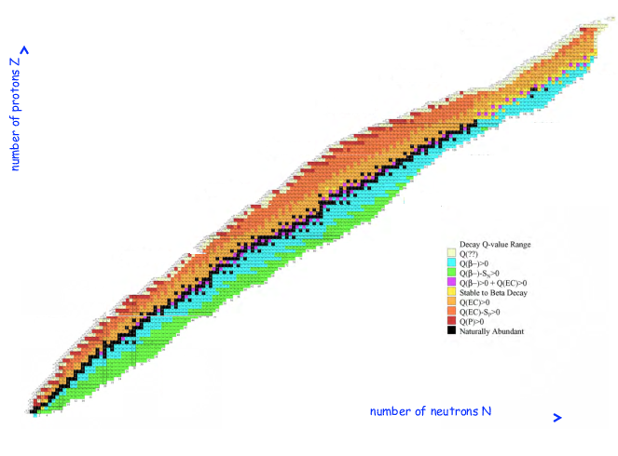
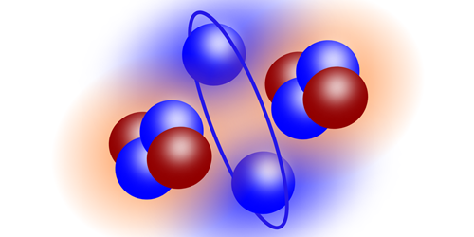
Atomic Nuclei
~3000 nuclei in the known chart
Complicated quantum many-body problems
A~100
Spin & Isospin
Poorly understood at microscopic level
Chart of Nuclei (R. Diehl/Springer)
Recently discovered molecule-like Structure of atom ground state (P.Li/Chinese Academy of Sciences).

Slide 3
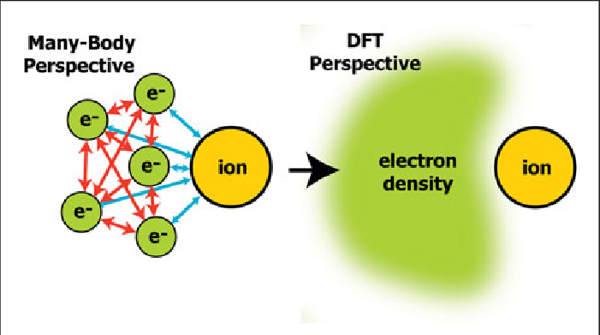
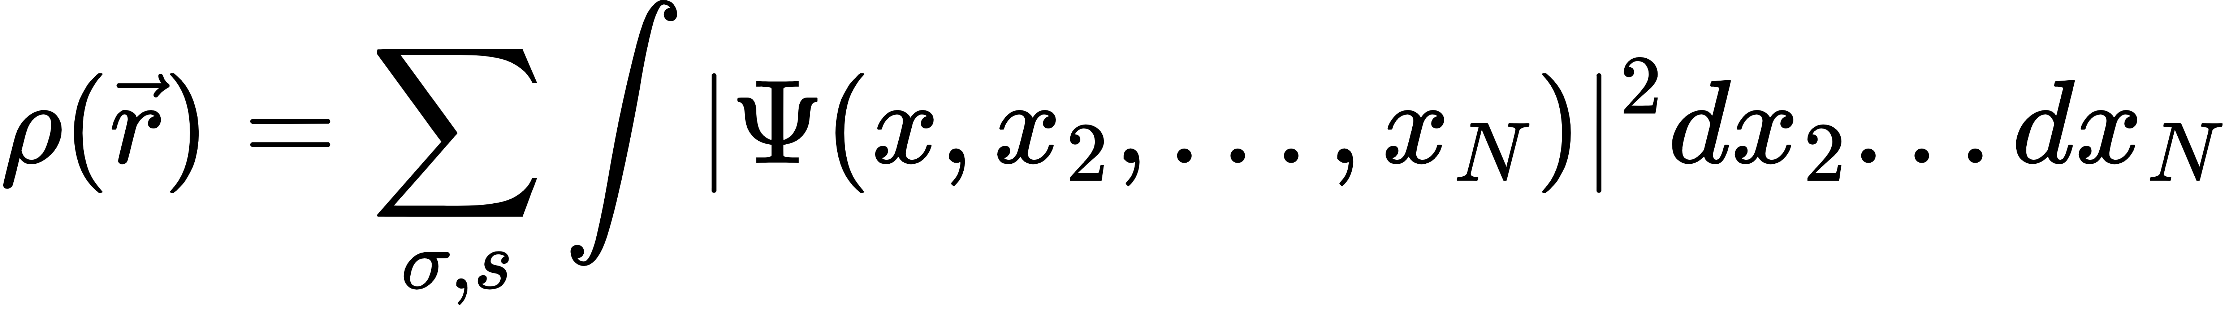
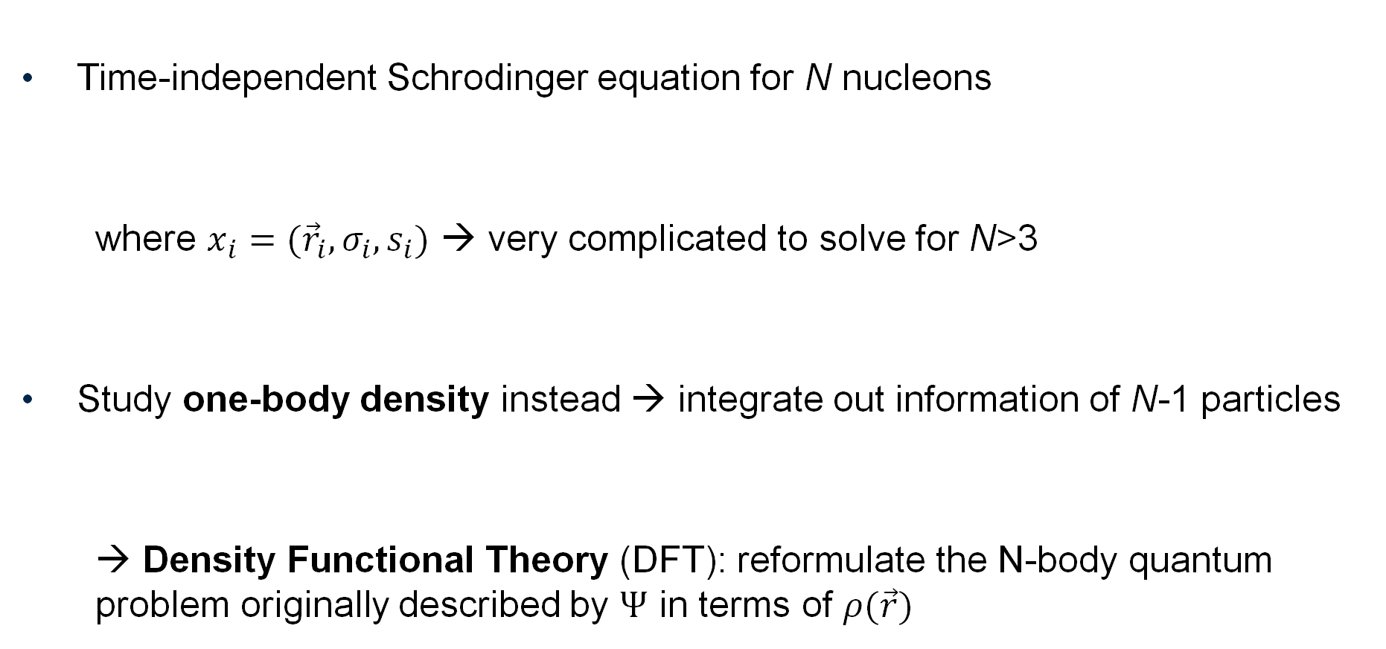
Quantum many-body problems
Time-independent Schrodinger equation for N nucleons
where $x_{i}=({\vec{r}}_{i},σ_{i},s_{i})$ → very complicated to solve for N>3
Study one-body density instead → integrate out information of N-1 particles
→ Density Functional Theory (DFT): reformulate the N-body quantum problem originally described by $Ψ$ in terms of $ρ(\vec{r})$
From usual QM to DFT (M.T. Lusk/Springer)
Hamiltonian
N-body wave function
position
isospin
spin

Slide 4
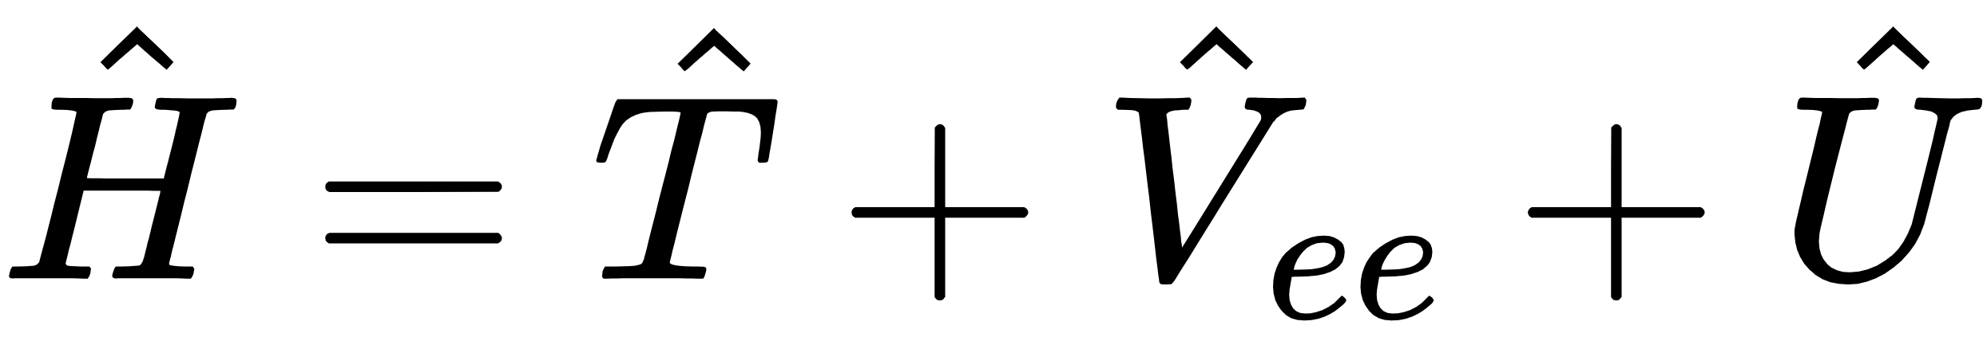
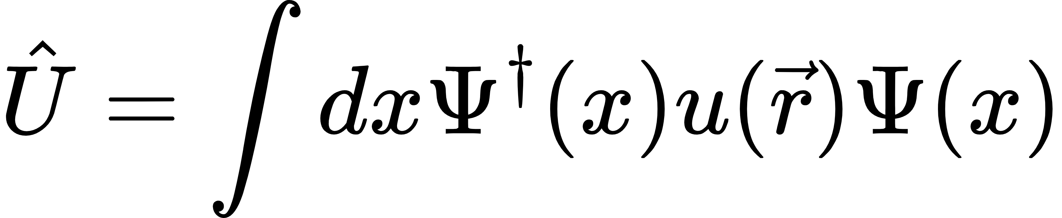
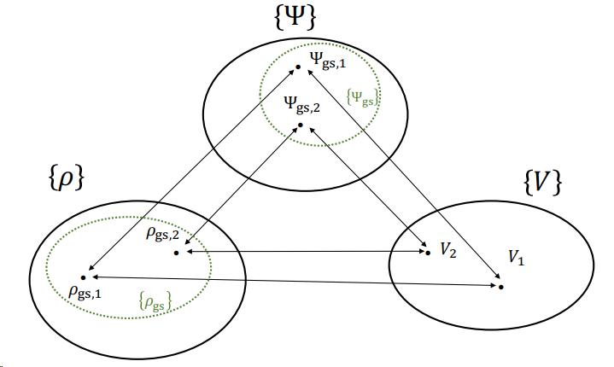
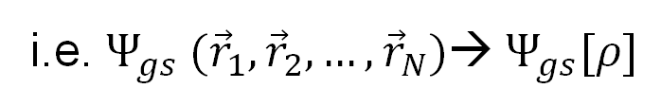
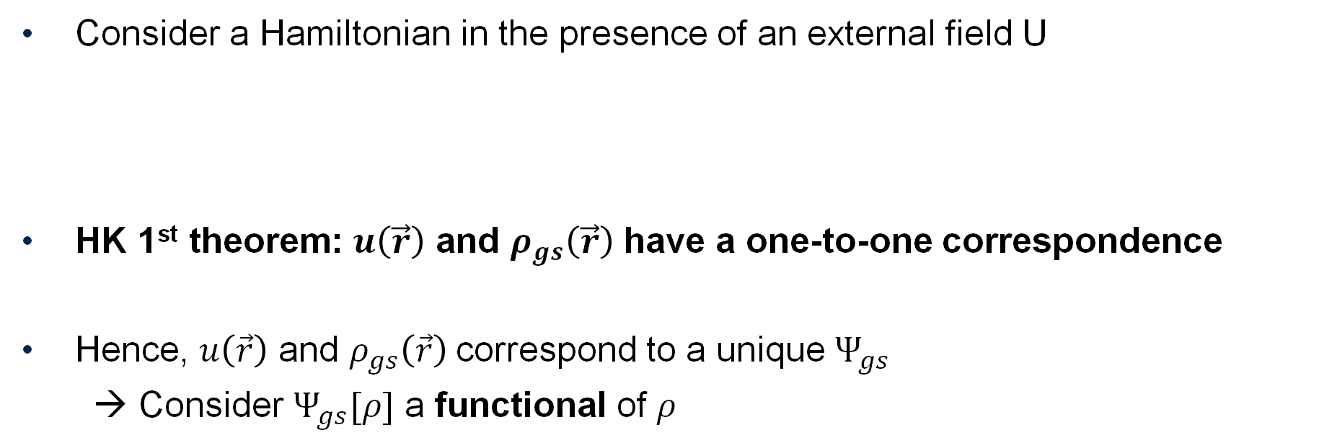
Hohenberg-Kohn (HK) theorem
Consider a Hamiltonian in the presence of an external field U
HK 1st theorem: $u\left(\vec{r}\right)$ and $ρ_{gs}\left(\vec{r}\right)$ have a one-to-one correspondence
Hence, $u\left(\vec{r}\right)$ and $ρ_{gs}\left(\vec{r}\right)$correspond to a unique $Ψ_{gs}$
→ Consider $Ψ_{gs}[ρ]$ a functional of $ρ$
kinetic
Electron-electron interaction
External potential
i.e. $Ψ_{gs} ({\vec{r}}_{1},{\vec{r}}_{2},…,{\vec{r}}_{N})$→$Ψ_{gs}[ρ]$
HK 1st theorem (T. Yokota/PhD thesis)

Slide 5
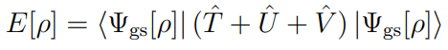

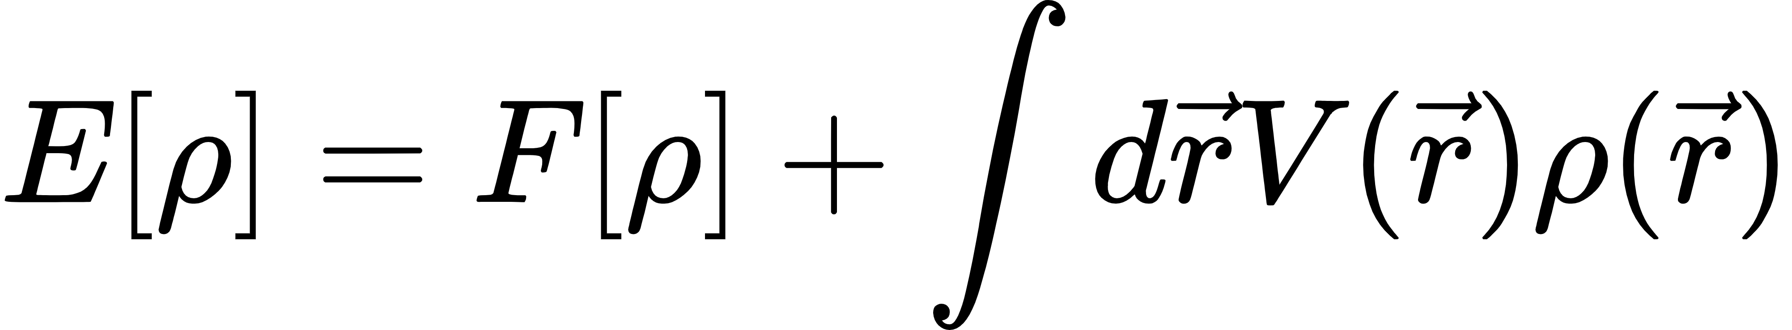
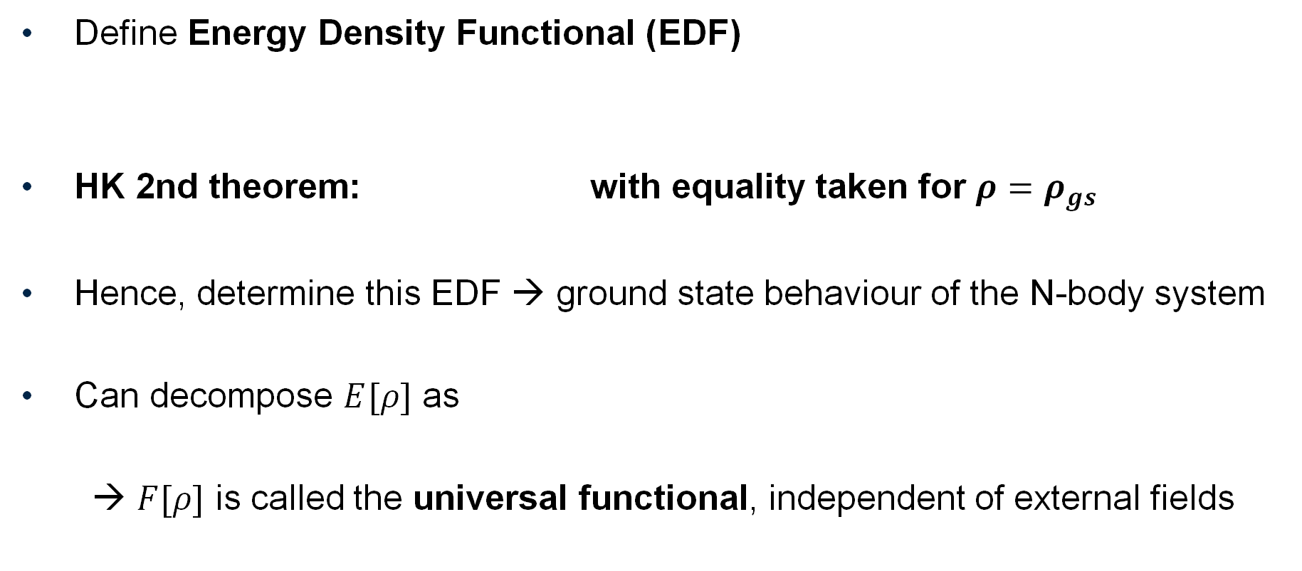
Hohenberg-Kohn (HK) theorem
Define Energy Density Functional (EDF)
HK 2nd theorem: with equality taken for ${ρ=ρ}_{gs}$
Hence, determine this EDF → ground state behaviour of the N-body system
Can decompose $E[ρ]$ as
→ $F[ρ]$ is called the universal functional, independent of external fields

Slide 6
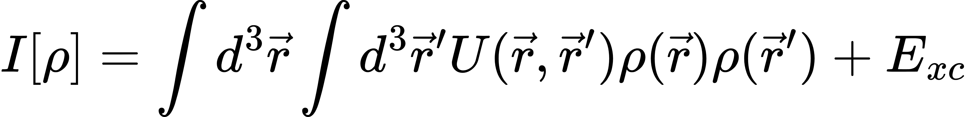


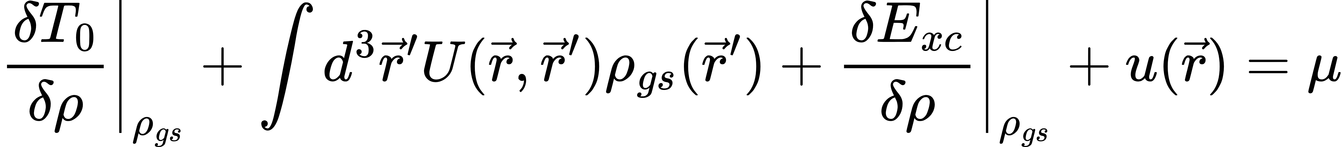
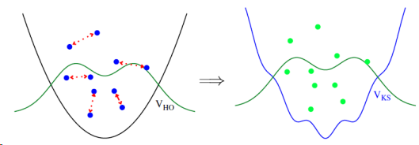
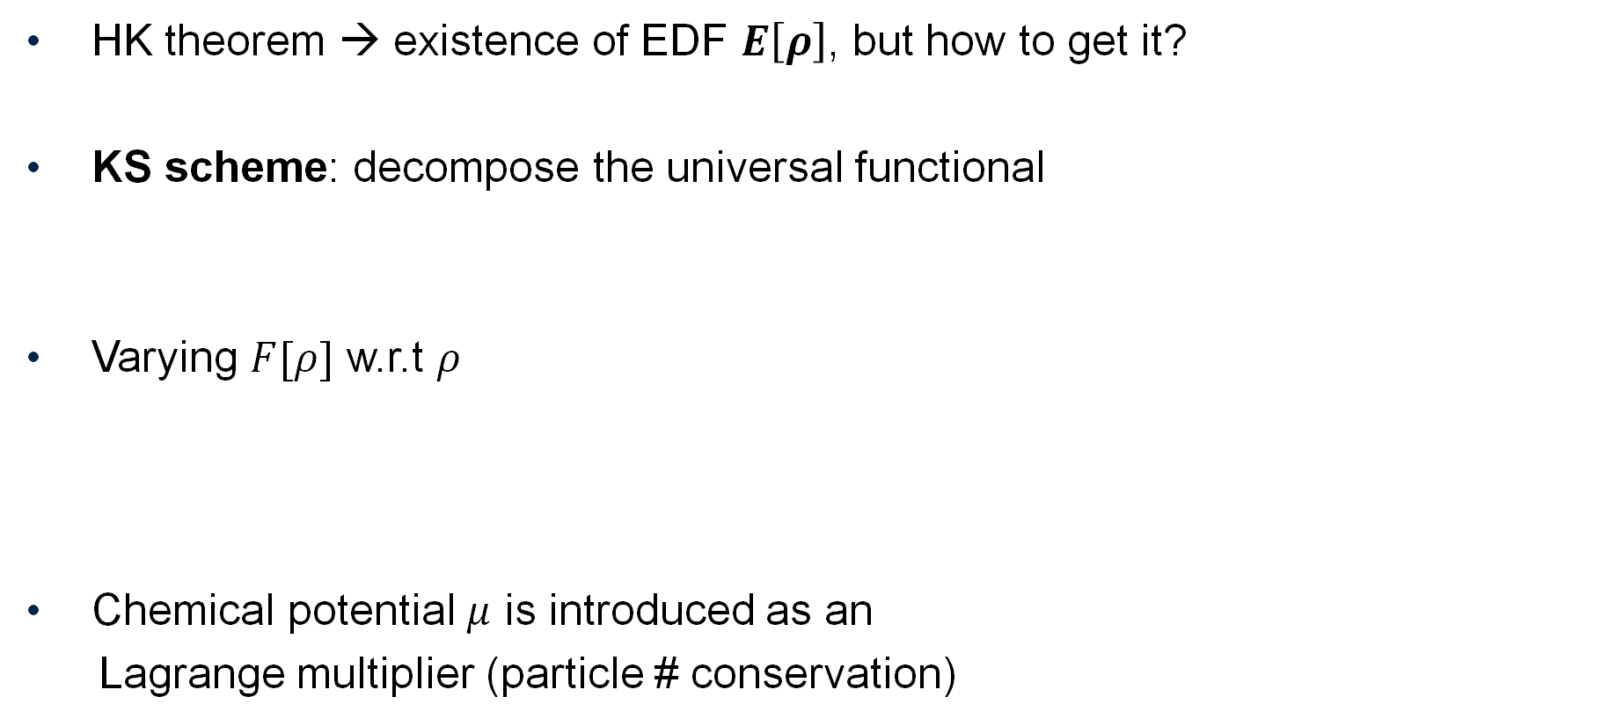
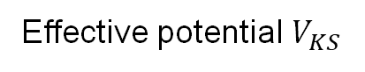
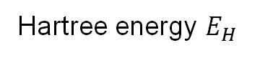
Kohn-Sham (KS) scheme
HK theorem → existence of EDF $E\left[ρ\right]$, but how to get it?
KS scheme: decompose the universal functional
Varying $F[ρ]$ w.r.t $ρ$
Chemical potential $μ$ is introduced as an
Lagrange multiplier (particle # conservation)
Non-interacting kinetic energy
Interaction energy
Hartree energy $E_{H}$
Exchange-correlation energy
Effective potential $V_{KS}$

Slide 7
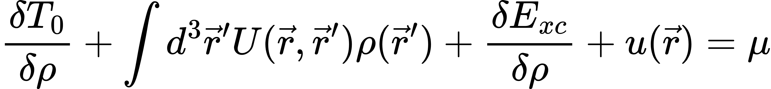
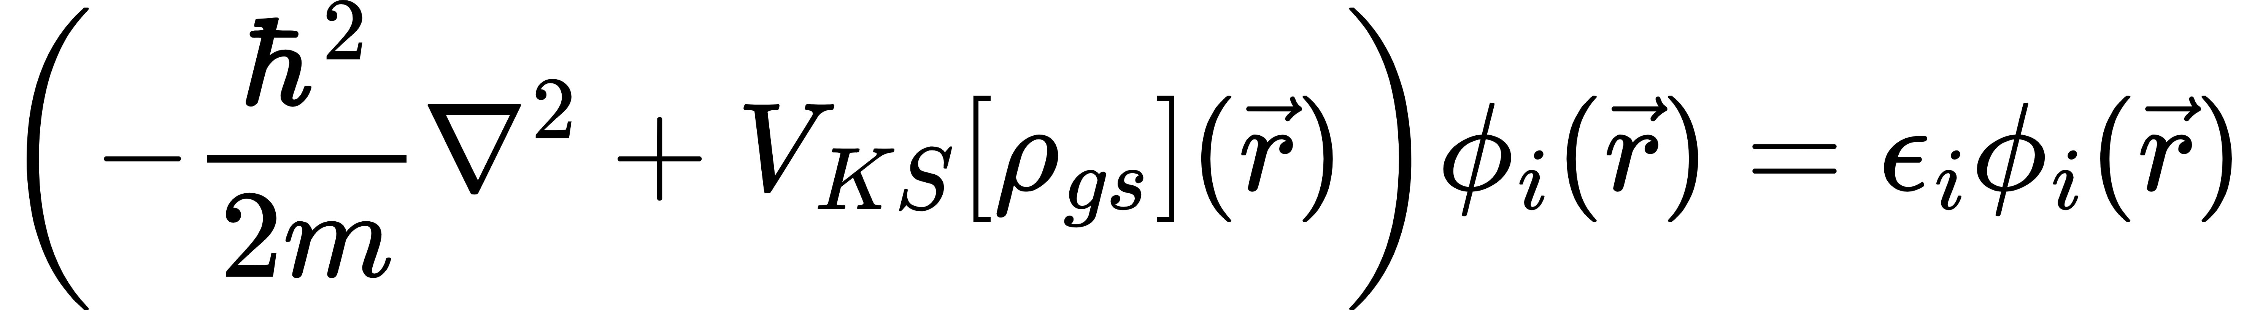
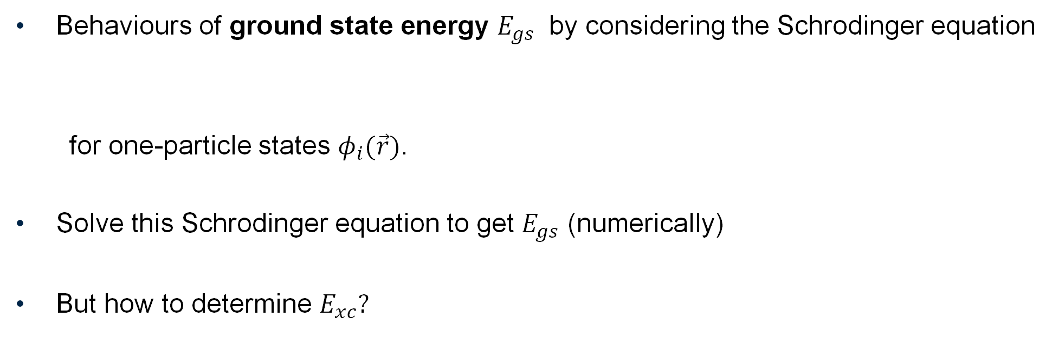
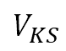
Kohn-Sham (KS) scheme
$$V_{KS}$$
Behaviours of ground state energy $E_{gs}$ by considering the Schrodinger equation
for one-particle states $φ_{i}(\vec{r})$.
Solve this Schrodinger equation to get $E_{gs}$ (numerically)
But how to determine $E_{xc}?$

Slide 8
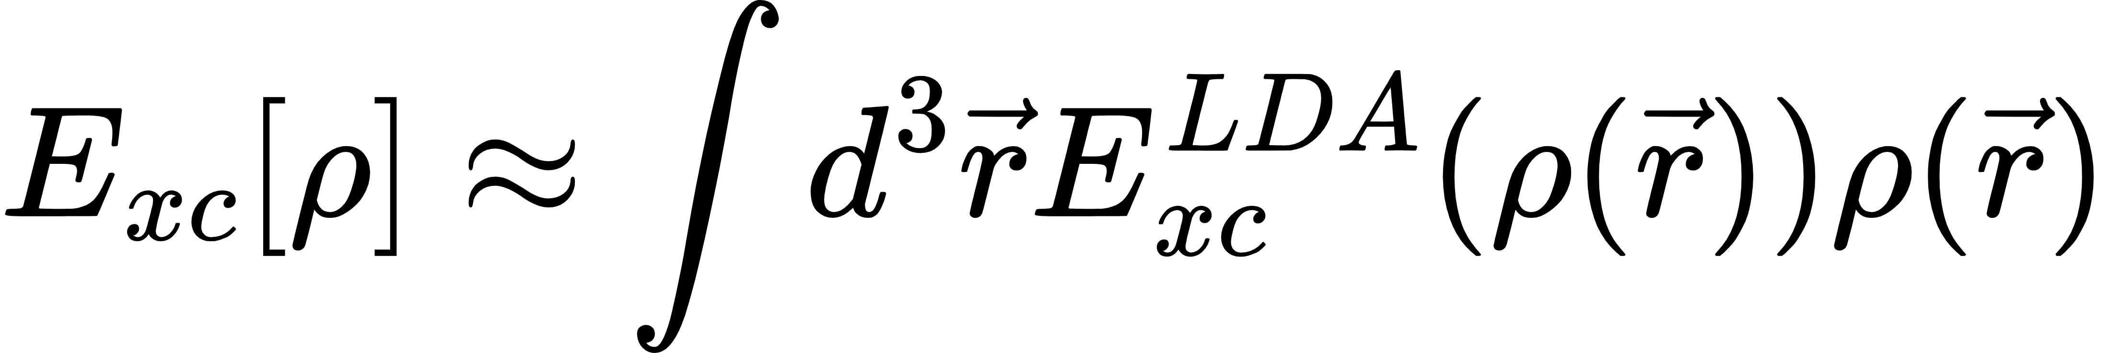
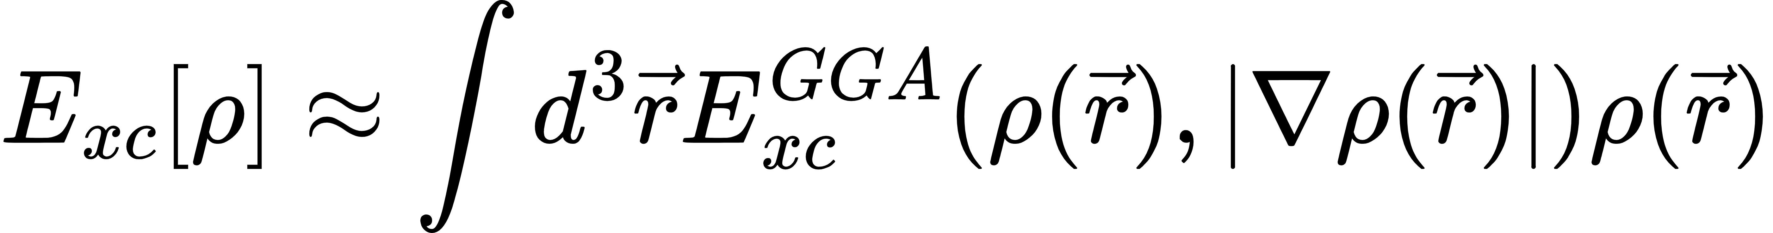
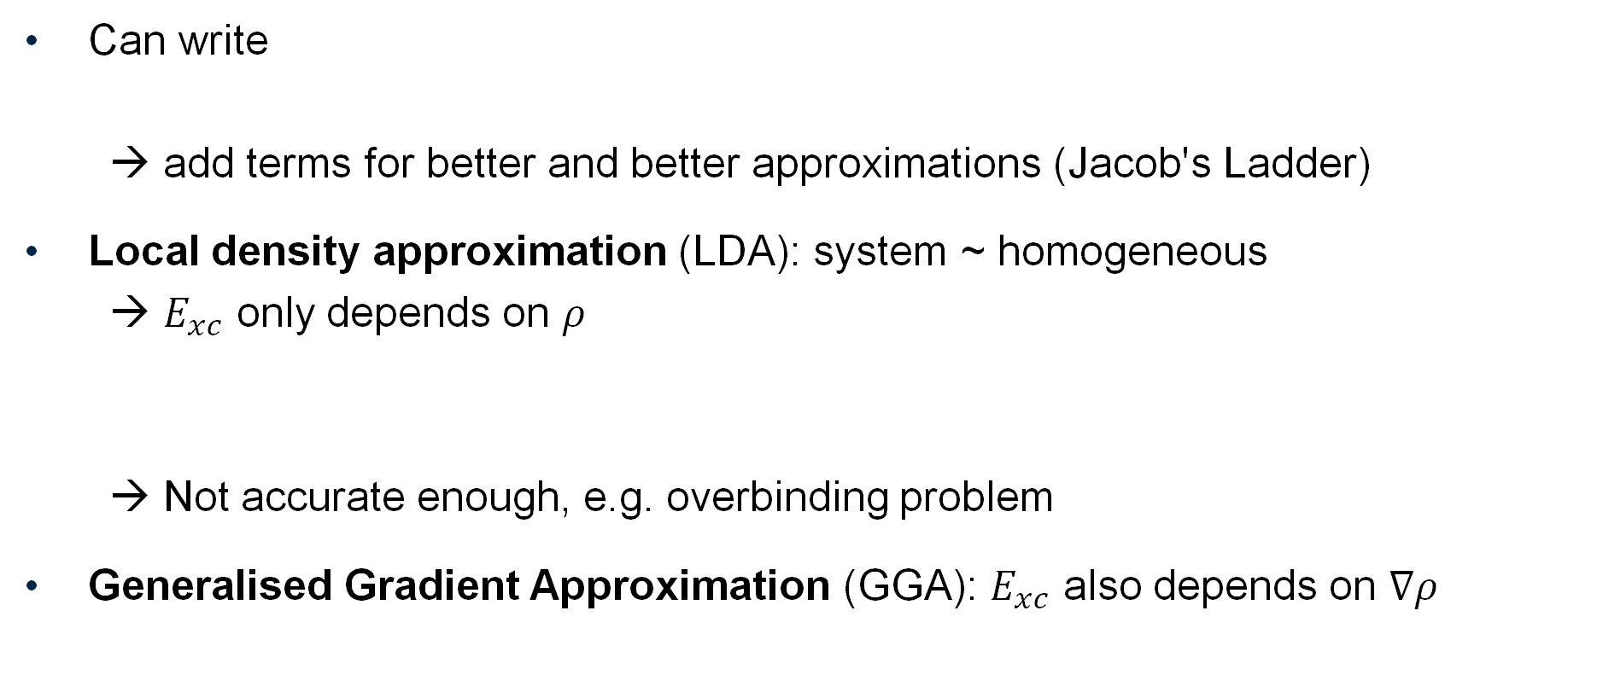
Determination of the $F[ρ]$
Can write
→ add terms for better and better approximations (Jacob's Ladder)
Local density approximation (LDA): system ~ homogeneous
→ $E_{xc}$ only depends on $ρ$
→ Not accurate enough, e.g. overbinding problem
Generalised Gradient Approximation (GGA): $E_{xc}$ also depends on $∇ρ$

Slide 9
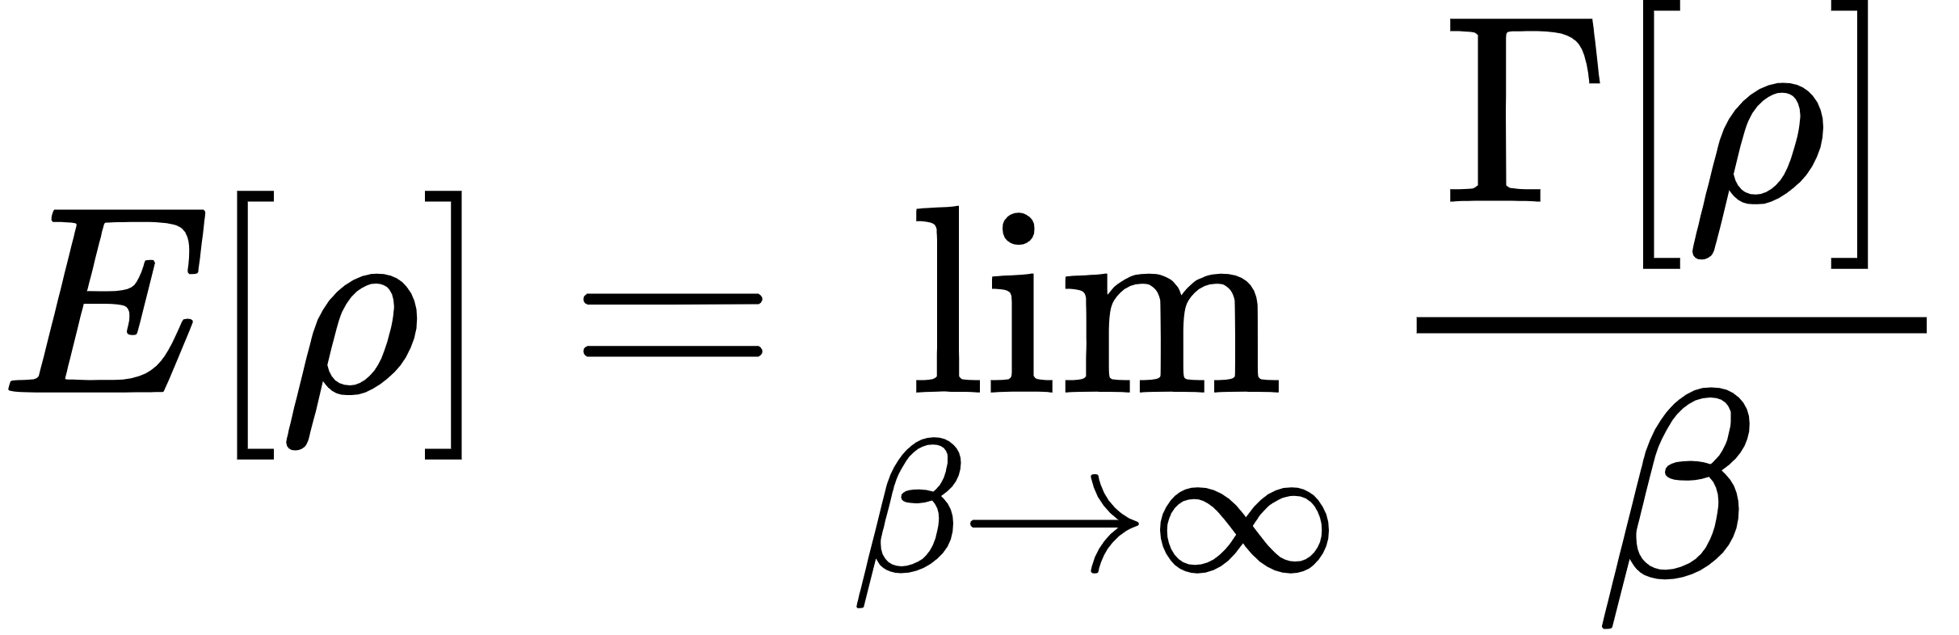

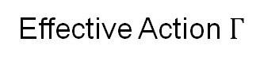
Functional Renormalisation group aided DFT
New systematic approach in recent years using Functional Renormalisation group (FRG) → FRG aided DFT (FRG-DFT)
EDF ←→ effective action
Why FRG-DFT?
Ab-initio non-perturbative method
RG-like flow equations are powerful calculation tools
Possible extension to improve the analysis of excited states using DFT
Get rid of contributions that we are not interested in
Action $S$
Effective Action $Γ$

Slide 10
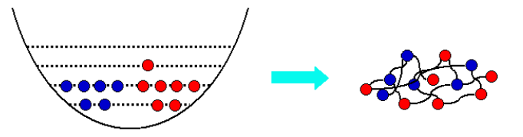
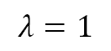
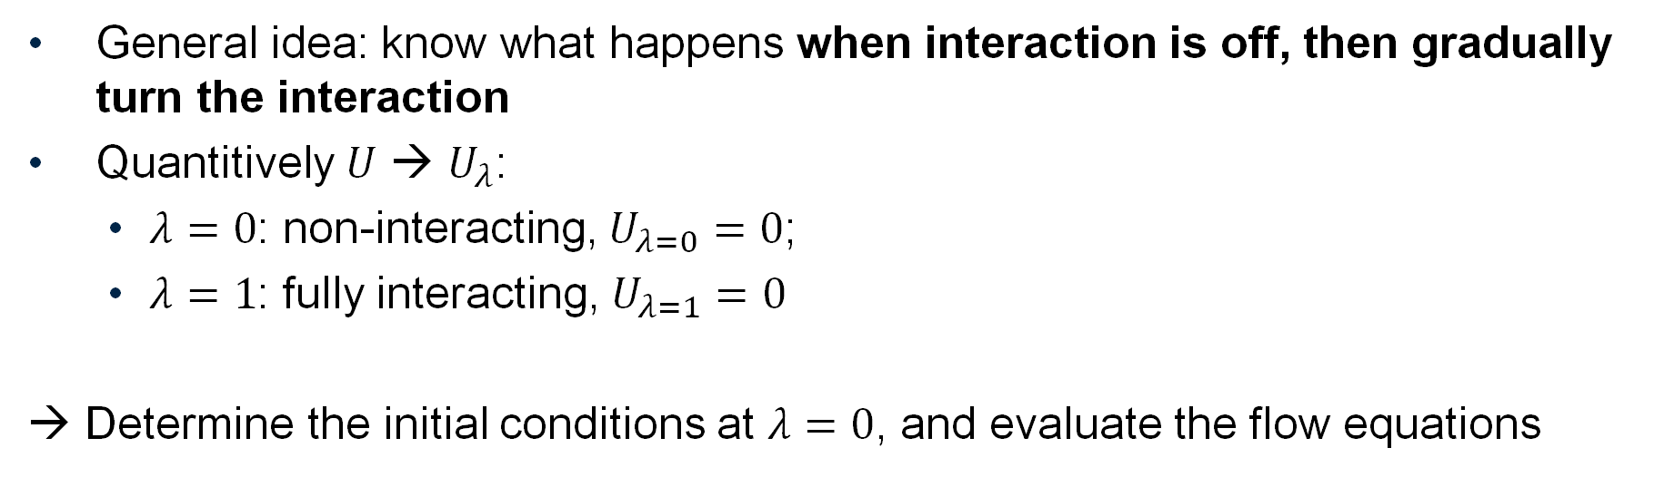
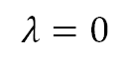
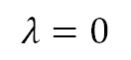
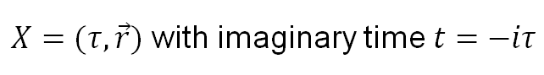
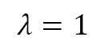
Functional Renormalisation group aided DFT
General idea: know what happens when interaction is off, then gradually turn the interaction
Quantitively $U$ → $U_{λ}$:
$λ=0$: non-interacting, $U_{λ=0}=0$;
$λ=1$: fully interacting, $U_{λ=1}=0$
→ Determine the initial conditions at $λ=0$, and evaluate the flow equations
$$λ=0$$
$$λ=1$$
(Schwenk & Polonyi, arXiv:0403011 [nucl-th])
$$λ=1$$
What we want to know
Flow determined by flow equations
$X=(τ,\vec{r})$ with imaginary time $t=−iτ$
What we know
$$λ=0$$

Slide 11
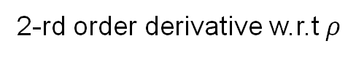
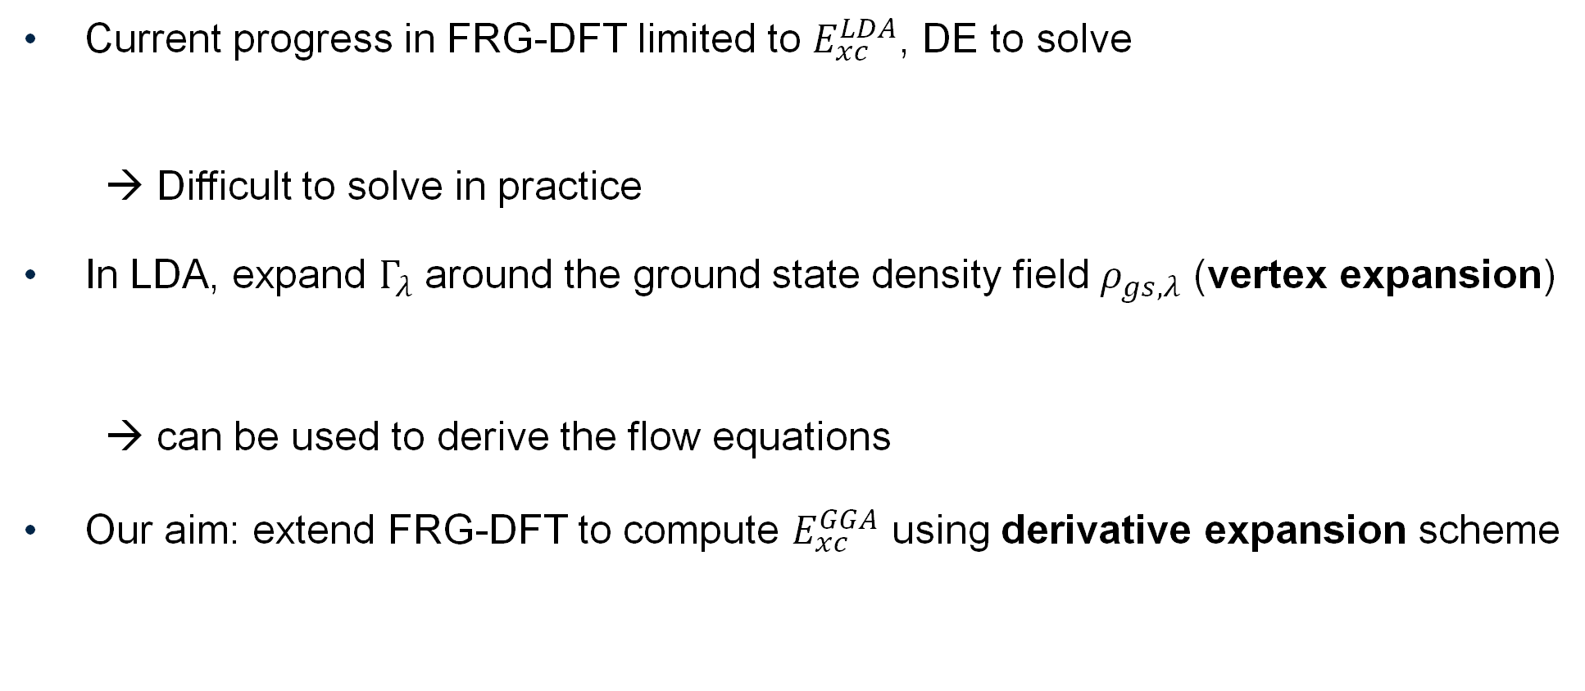
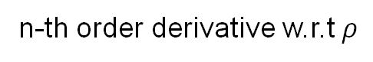
Functional Renormalisation group aided DFT
Current progress in FRG-DFT limited to $E_{xc}^{LDA}$, DE to solve
→ Difficult to solve in practice
In LDA, expand $Γ_{λ}$ around the ground state density field $ρ_{gs,λ}$ (vertex expansion)
→ can be used to derive the flow equations
Our aim: extend FRG-DFT to compute $E_{xc}^{GGA}$ using derivative expansion scheme
2-rd order derivative w.r.t $ρ$
n-th order derivative w.r.t $ρ$
Expansion coefficients to be determined

Slide 12
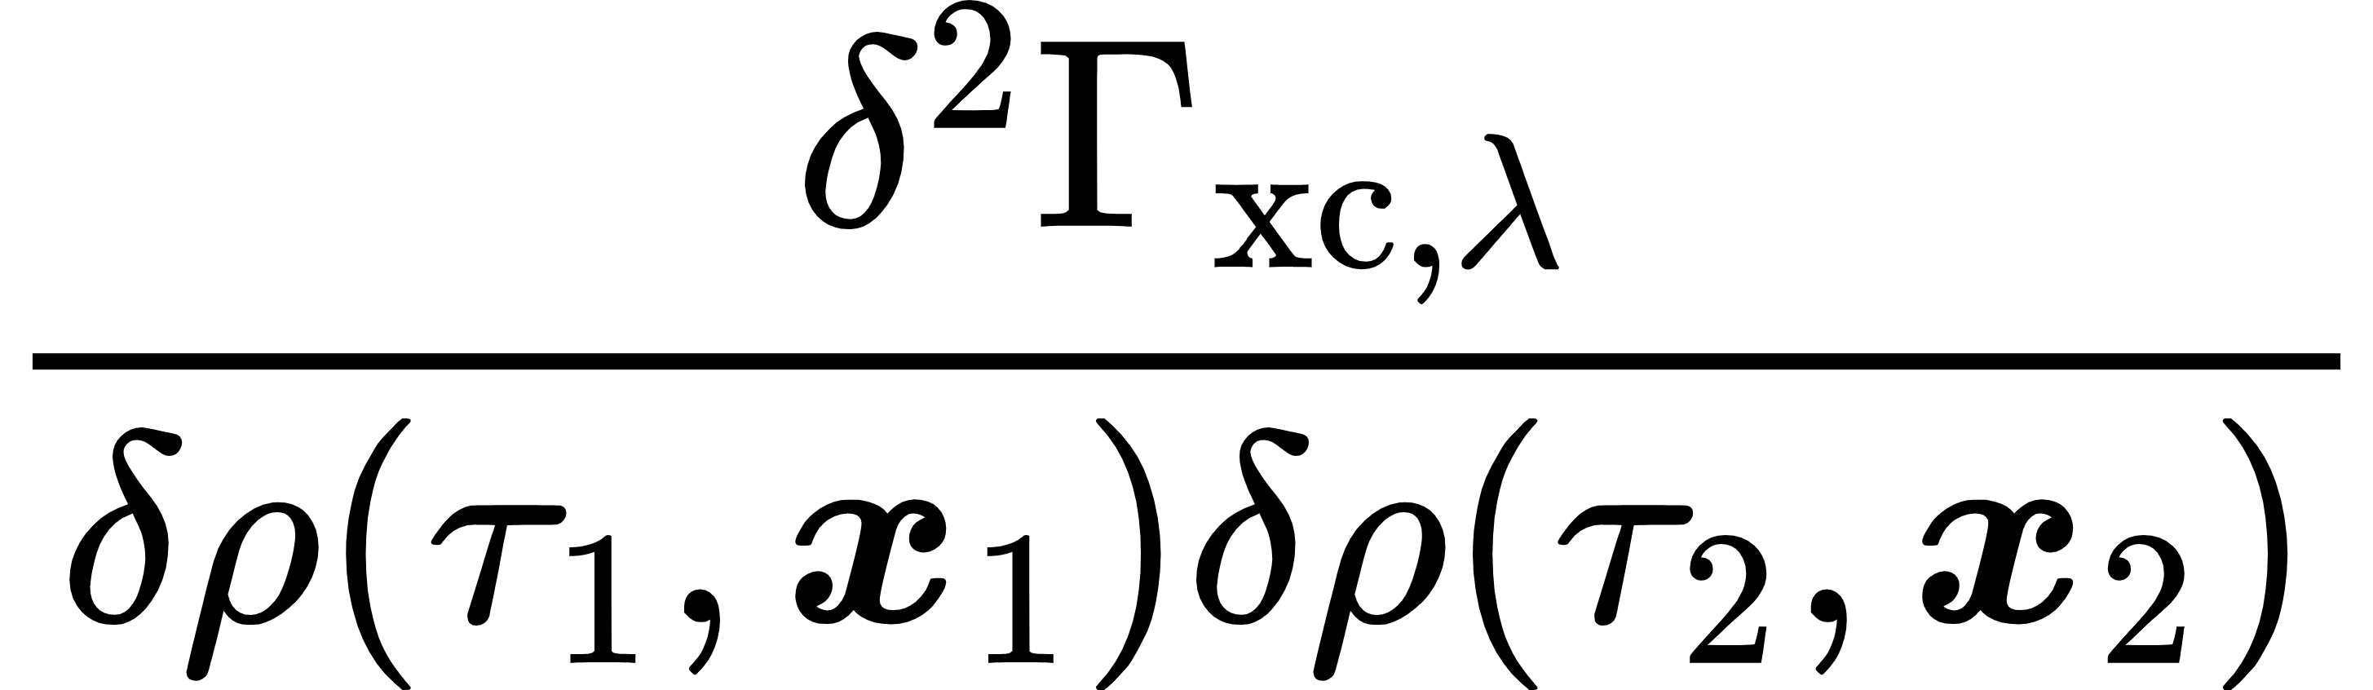
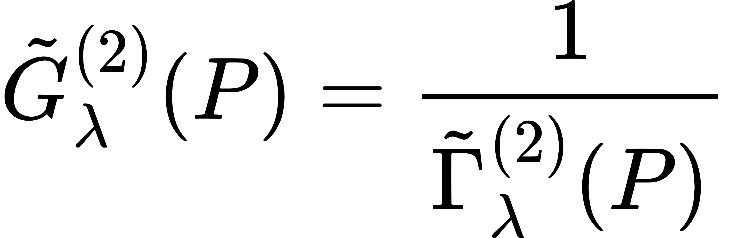
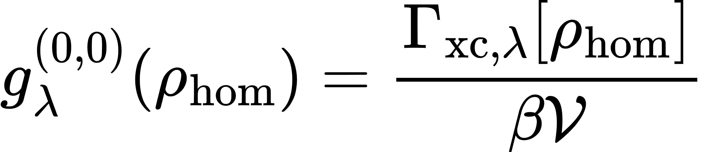
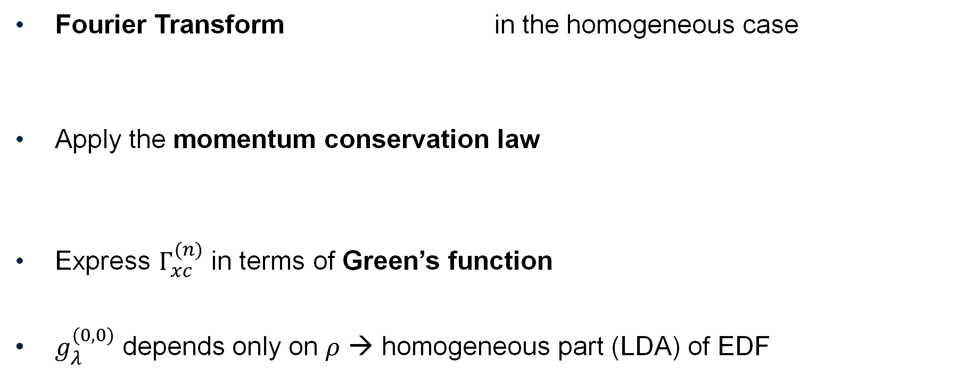
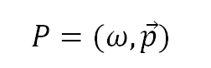
Flow equations
Fourier Transform in the homogeneous case
Apply the momentum conservation law
Express $Γ_{xc}^{(n)}$ in terms of Green’s function
$g_{λ}^{(0,0)}$ depends only on $ρ$ → homogeneous part (LDA) of EDF
$$P=(ω,\vec{p})$$

Slide 13
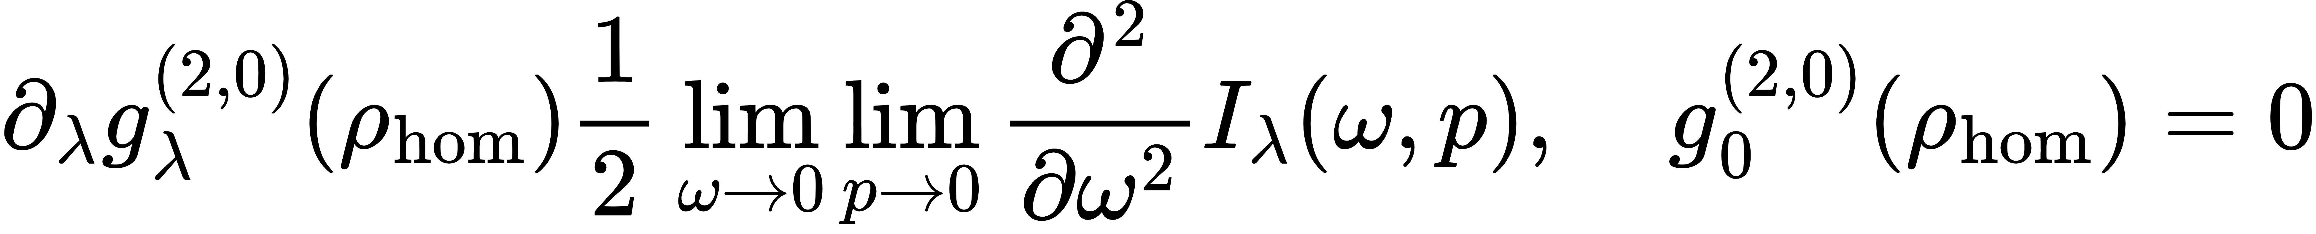
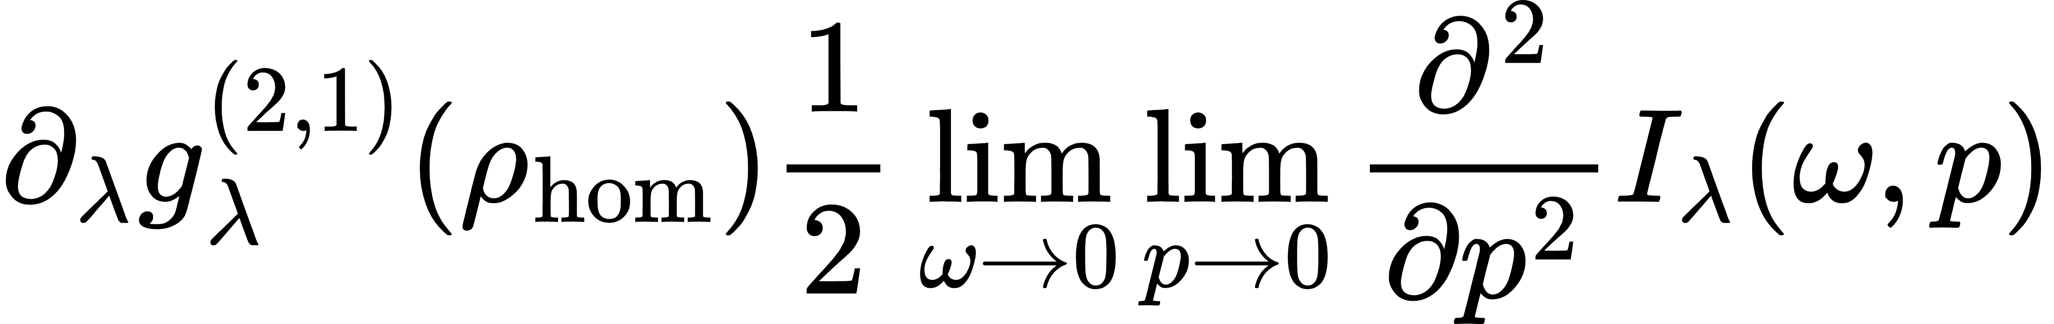
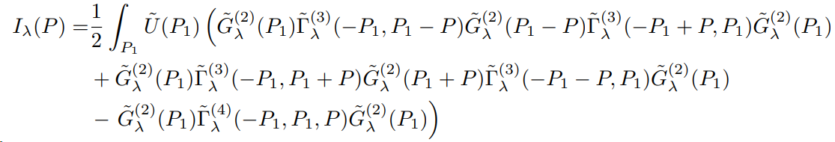
Flow equations
Homogeneous term:
Inhomogeneous terms:

Slide 14
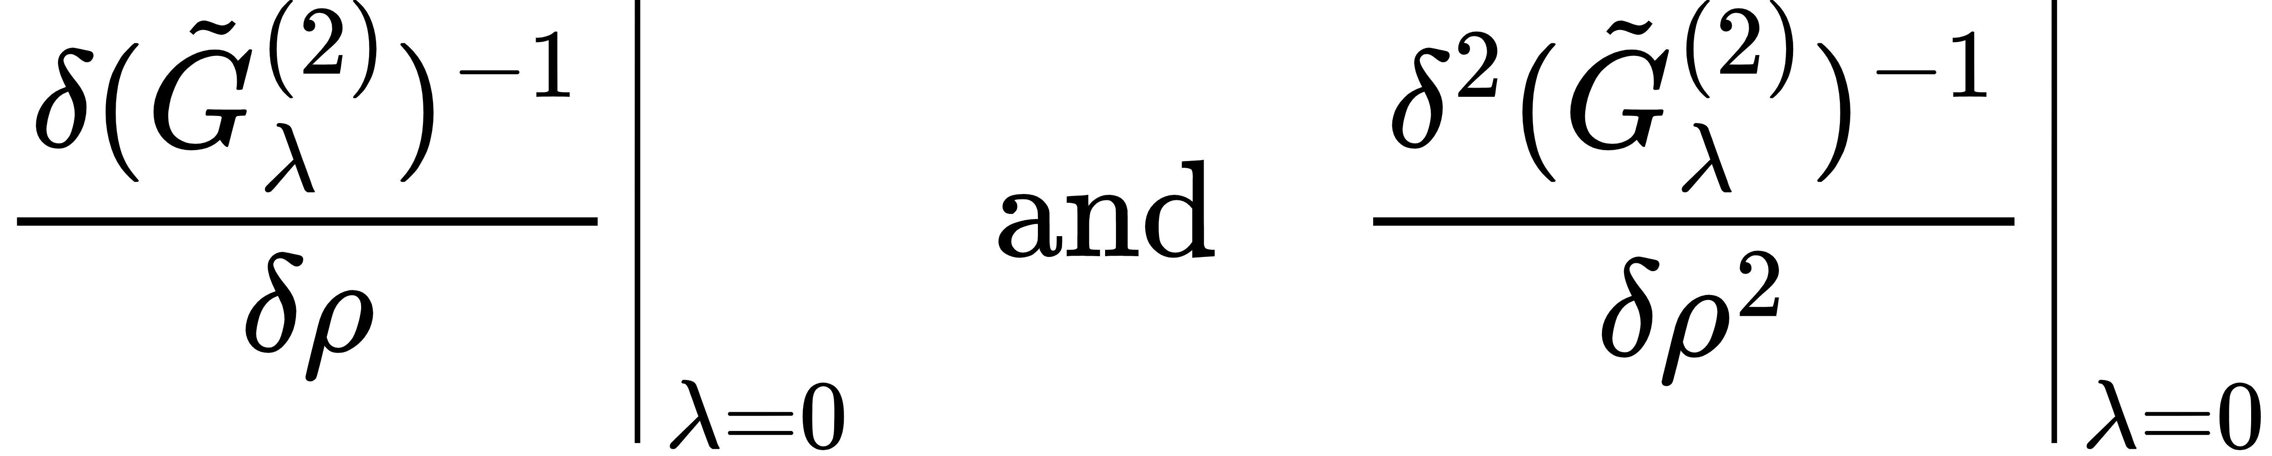
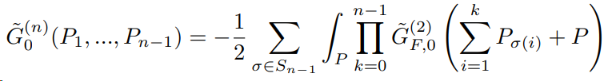
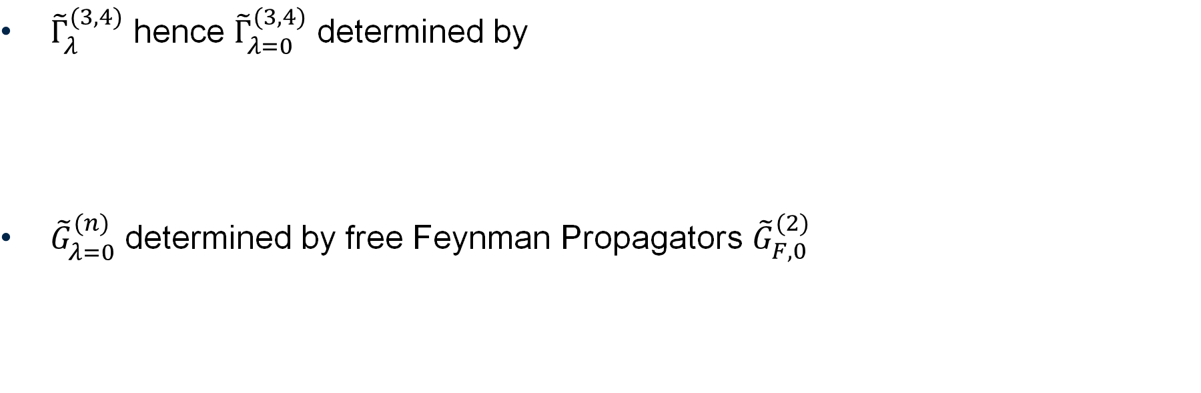
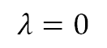

Initial Conditions
$$λ=1$$
What we want to know
${\tilde{Γ}}_{λ}^{(3,4)}$ hence ${\tilde{Γ}}_{λ=0}^{(3,4)}$ determined by
${\tilde{G}}_{λ=0}^{(n)}$ determined by free Feynman Propagators ${\tilde{G}}_{F,0}^{(2)}$
What happens here?
Flow determined by flow equations
What we know
$$λ=0$$
Permutation group

Slide 15




Evaluating the limits
By ${\tilde{Γ}}_{λ}^{(3,4)}$, $I_{λ}$ becomes
where $C_{λ=0}$ can be expressed as
Both$\lim_{ω,\vec{p}→0}{C_{λ=0}\left(P\right)=∞}$ and $\lim_{ω,\vec{p}→0}{{\tilde{G}}_{λ=0}^{(2)}{(P)}^{2}=∞}$→ Still cannot evaluate the limits
$θ$ = step function

Slide 16

Evaluating the limits
Evaluate $C_{λ=0}\left(P\right)$ and ${\tilde{G}}_{λ=0}^{(2)}{(P)}^{2}$ separately
→ more explicit expression for $I_{λ=0}\left(P\right)$
The limits of $\frac{∂^{2}}{∂{\vec{p}}^{2}}I_{λ=0}\left(P\right)$ henceforth obtained can be evaluate
→ $g_{λ=0}^{\left(2,1\right)}(ρ_{hom})$ solved
Still unclear if $g_{λ=0}^{\left(2,0\right)}(ρ_{hom})$ can be solved in the same way…

Slide 17
Summary & Outlook
DFT is the only known way to study quantum many-body problems with large N
FRG is a powerful tool for the ab-initio construction of DFT
We extended FRG-DFT to GGA based on the derivative expansion method
→ incorporate in FRG-DFT how EDF depends on the density field gradient
A limit remained to be evaluated & physical interpretations?
Needs to be numerically and mathematically validated

Slide 18
Thank you for listening!

